Slide 1
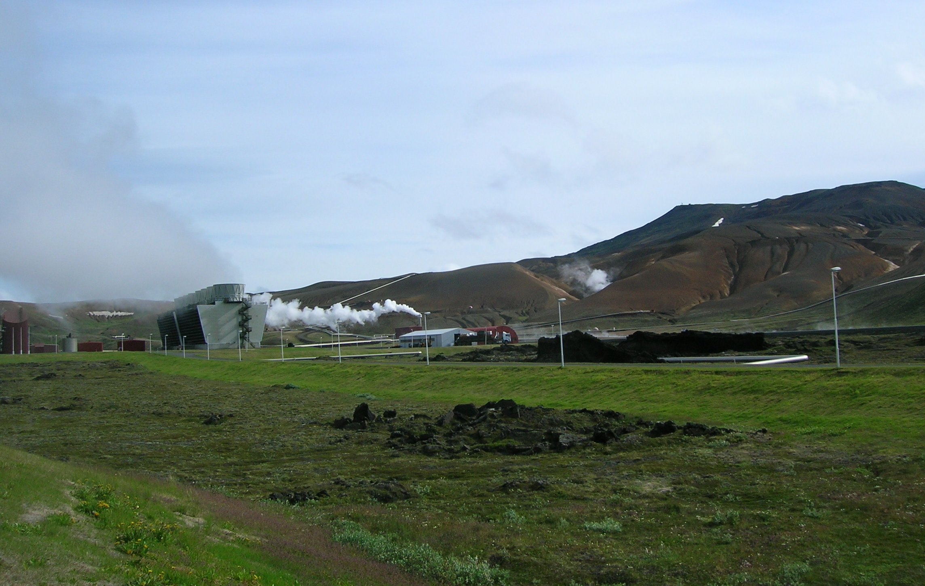
Supercritical Geothermal Energy
Marie VIOLAY
04-12-2024

Slide 2
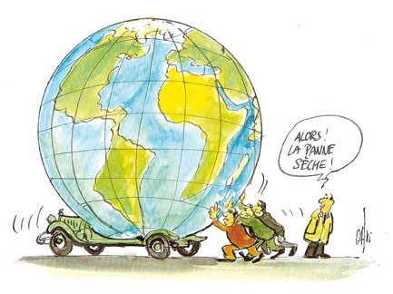
Geothermal energy: an important green alternative energy source!
Geothermal energy uses the Earth's internal heat and is
a renewable and inexhaustible energy at human scale
1

Slide 3
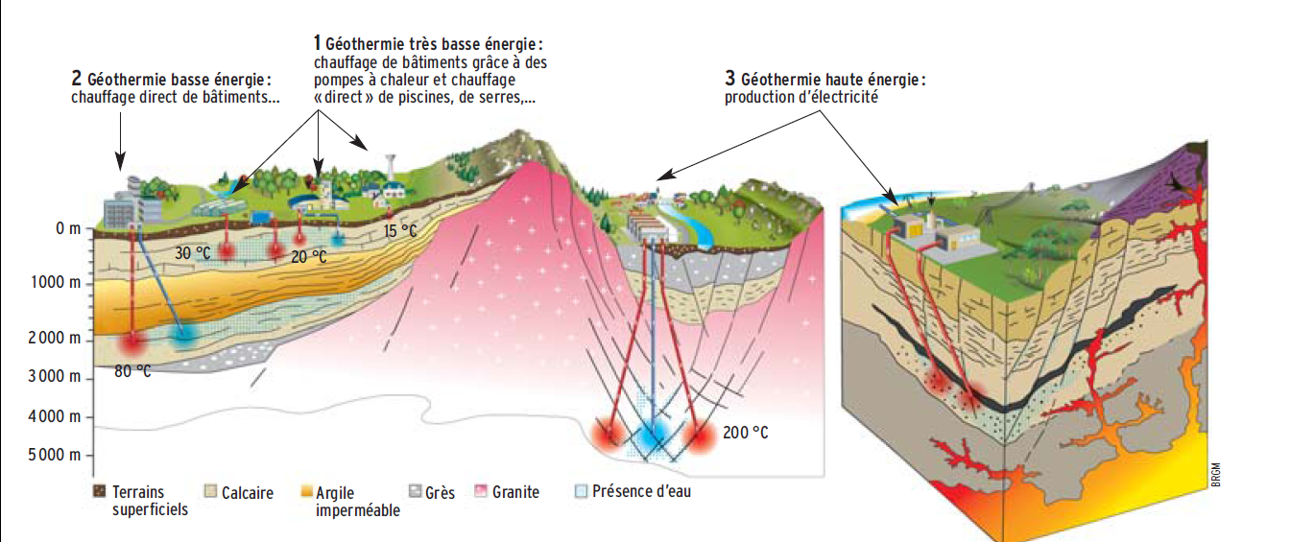
Geothermal energy: an important green alternative energy source!
Heating system of the building
Electricity
Low energy
Very low energy
High energy
BRGM, (2010)
2
Notes:
2 TYPES
CHAUFFAGE BAT
ELECTRICITE

Slide 4
Geothermal energy: an important green alternative energy source!
Heating system of the building
Electricity
Low energy
Very low energy
High energy
BRGM, (2010)
2
Notes:
2 TYPES
CHAUFFAGE BAT
ELECTRICITE

Slide 5
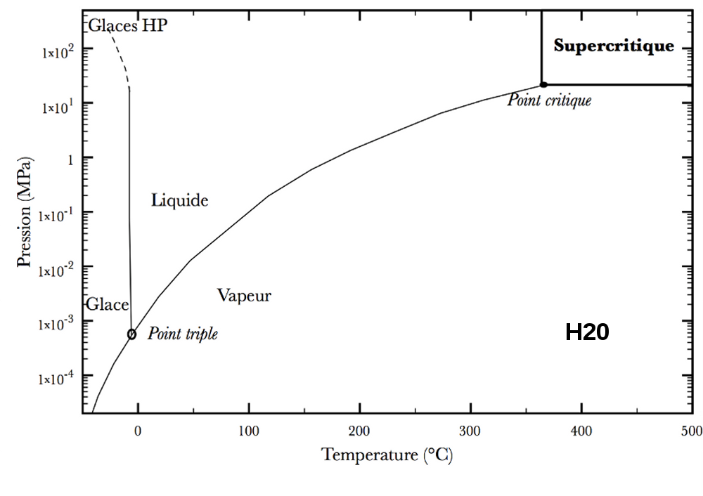
Supercritical conditions : phase diagram

Slide 6
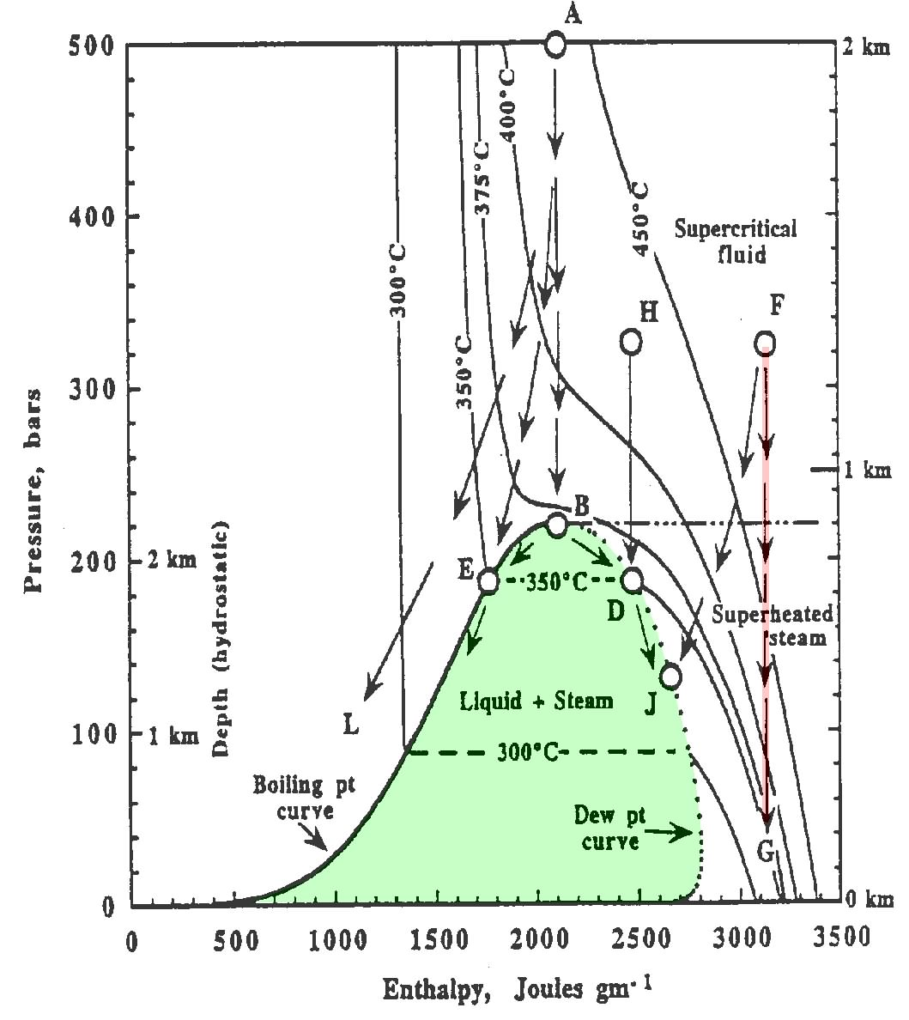
Supercritical conditions : phase diagram
Fluide
supercritique
Point triple
de l’eau
•

Slide 7
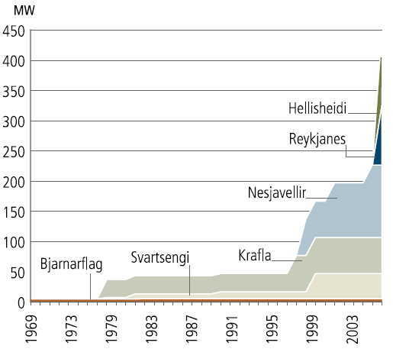
Supercritical fluid interest?
x 10
(energy production)
Conventional geothermal
exploitation (200°C - 350°C)
Supercritical pt pure water : 374°C 22 MPa
450°C
Pressure (Bars)
Installed capacity of geothermal
power plants in Iceland (1969–2006)
Enthalpy (joules.g.mol⁻¹)
After ORKUSTOFNUN, (National energy Autority) (2006)
Fournier, (1999)
Producing supercritical fluid will require the drilling of wells at temperatures upper than 450°C and at depths of 4-5 km
3
Notes:
LEADER MONDIAL
DIAGRAMME PRSSION/ ENTHALPY
ISOTHERME
POINT EBULITION
SEPARATION 2 PHASES (VAPEUR/GAZ)

Slide 8
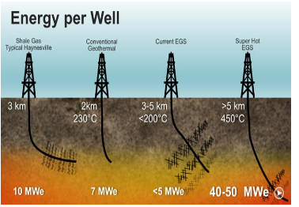

Slide 9
Seawater properties and “supercritical” regime (variations at the triple point, close to 380°C)
P = 23.5 MPa
Viscosity (pink)
Incompressibility (green)
Density (blue)
Enthalpy (yellow)
Specific heat (black)
³⁰⁰ T_{pc}⁴⁰⁰ ⁵⁰⁰

Slide 10
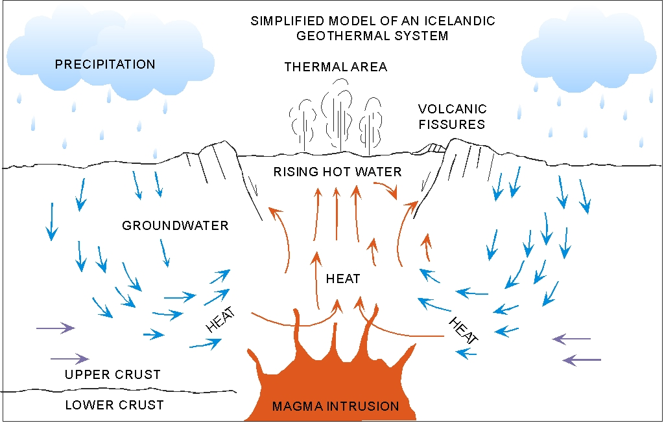
Unconventional geothermal energy
IDDP
2 km
5 km
reservoir at
supercritical
conditions

Slide 11
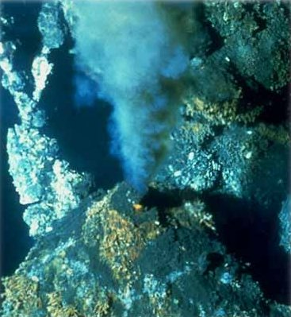
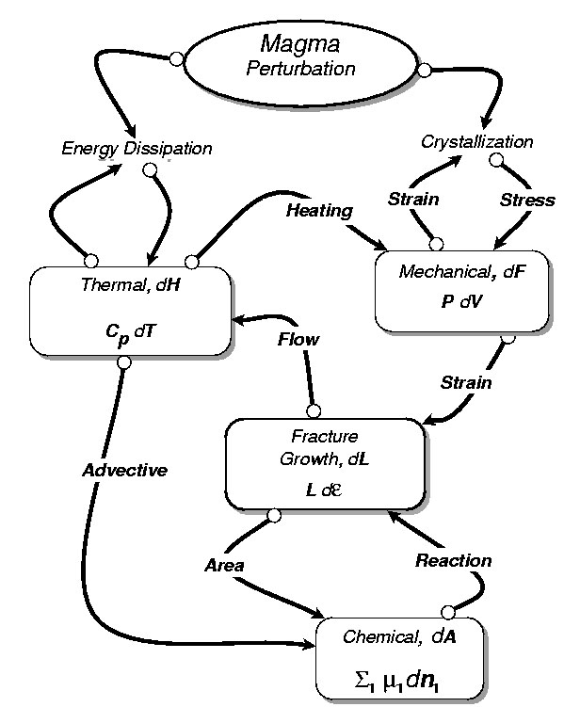
Complexity and Supercritical Conditions
interactions between heat,
stresses, fracturing,
rocks physics (Ø, K, R_{o}, λ, ...),
fluids flow and nature (p, T, Cw, ...),
rock and fluids chemistry ???
Interactions between :
-heat,
-stresses (fracturing),
-rocks physics (Ø, K, Ro, l, ...),
-nature of rocks,
Fluids flow (p, T, Cw, ...),
fluid/rock interactions (chemistry ?)
(after Norton, 2002)
( After Norton, 2002)

Slide 12
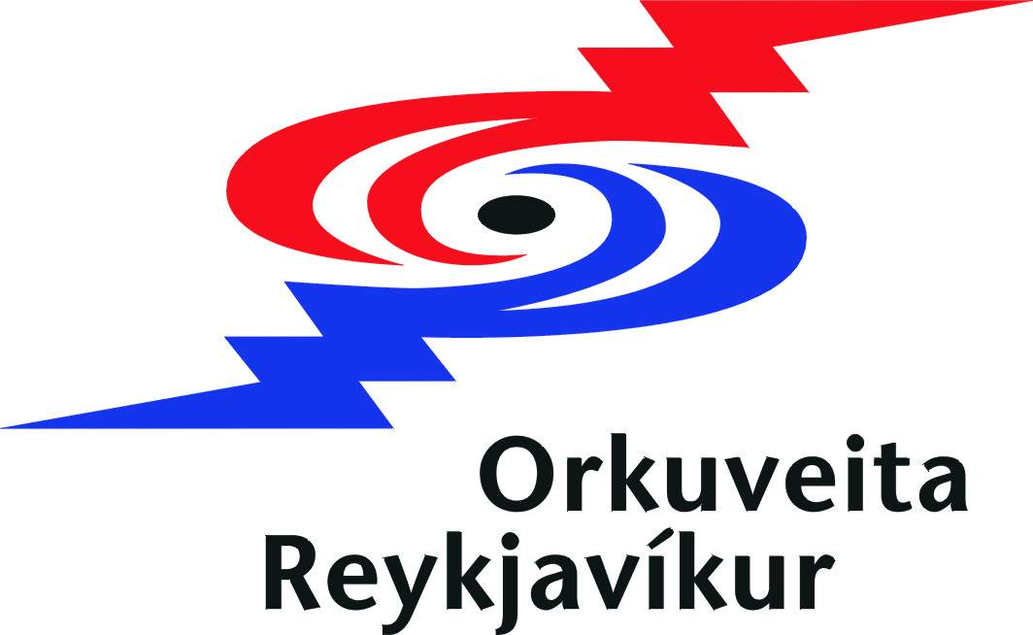
Example

Slide 13
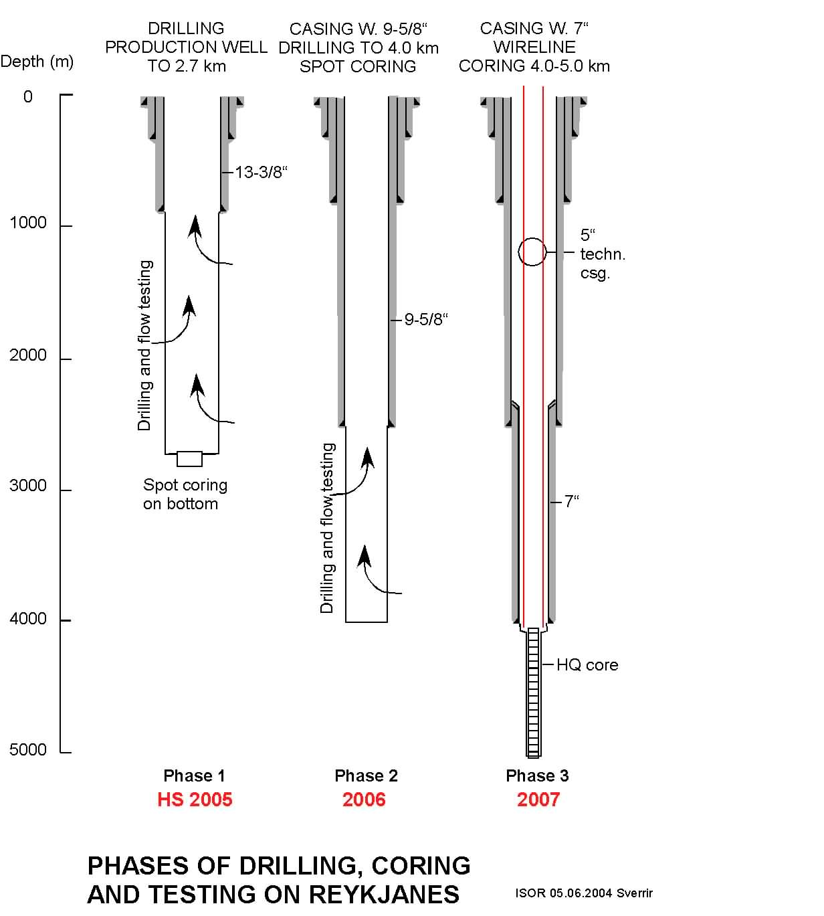
Design C
Turn to design A
according to
Feasibility Report
Design A
13 3/8” safety casing to 2.4 km
9 5/8” production casing
to 3.5 km
HQ coring and
if needed:
8 ½” reaming of core hole
7” slotted liner
+ spot cores
Well in Krafla rotary drilled in 2008 in one phase to ~3.5 km, including several spot cores, and deep casings cemented.
In 2008 or 2009 – new rig in and continuous coring to ~4.5 km
Geysir rig
DOSECC

Slide 14
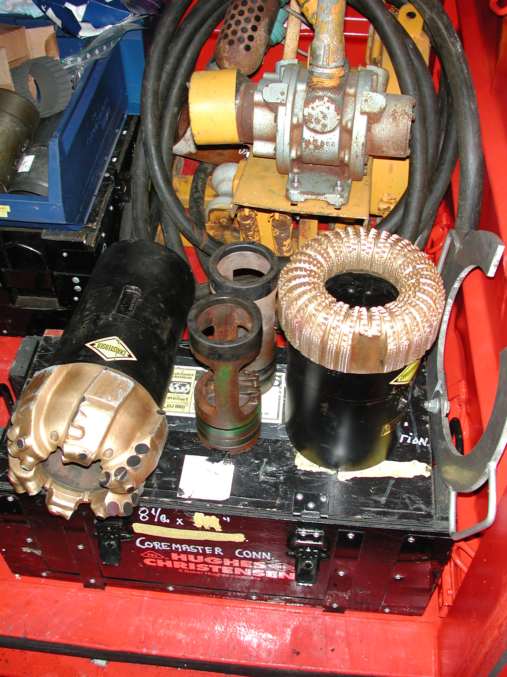
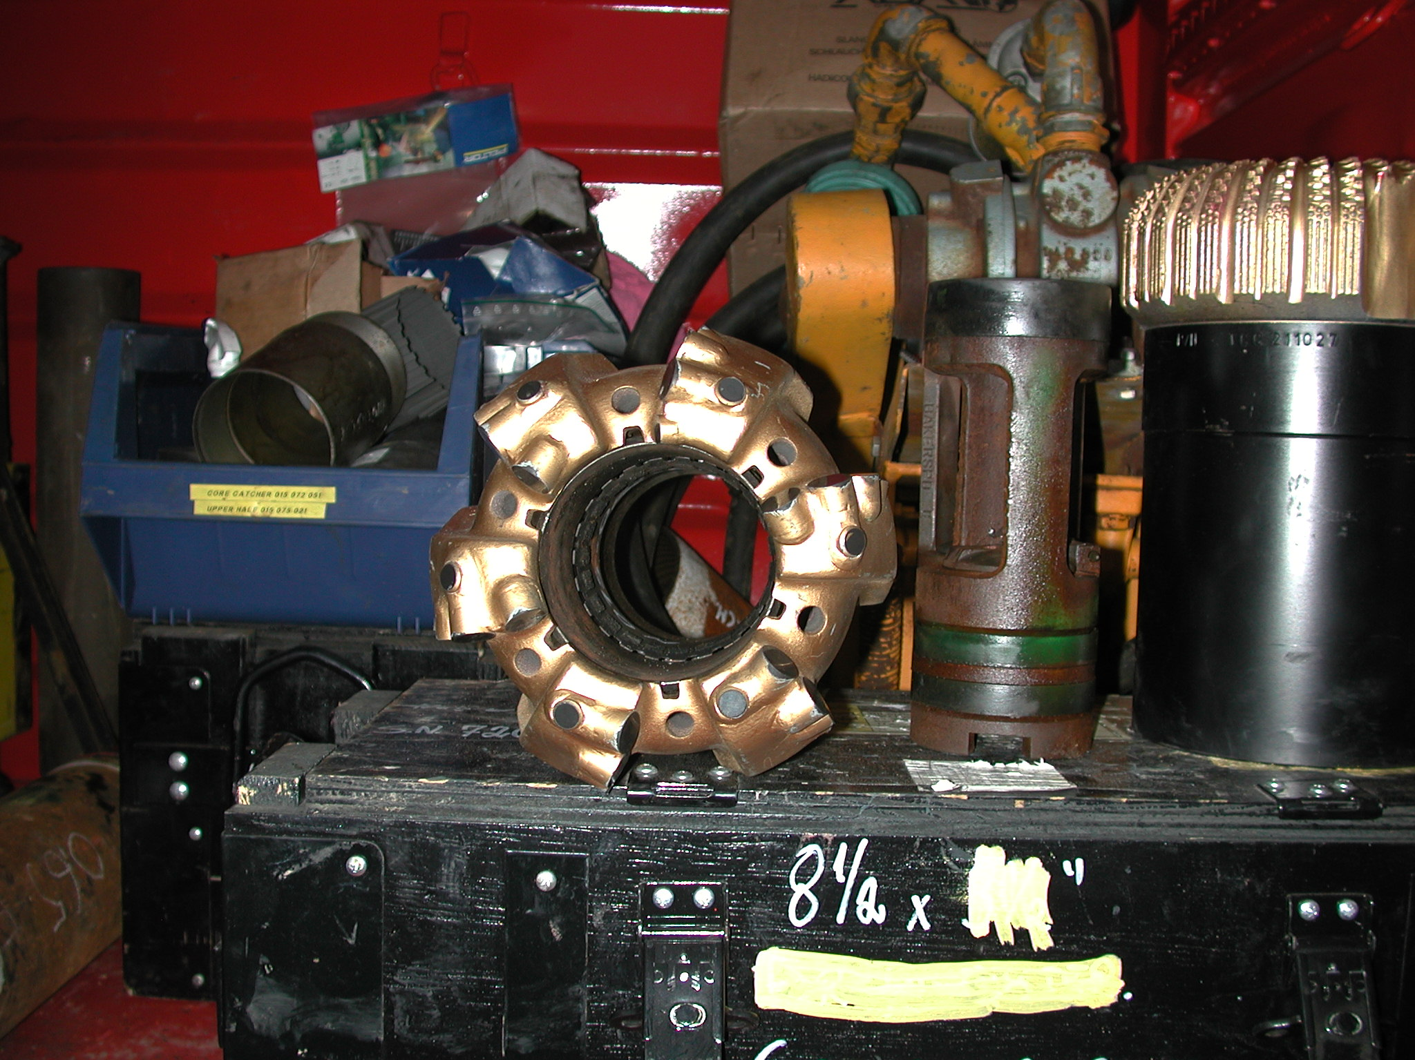
Notes:
Baker Hughes (Christensen) 8 ½” core bits for spot coring in phase 2. The PCD bit on the left and the right hand side og the pictures is a new model, that was used for this spot coring operation. This bit is two ttimes more expensive that the bit in middle – which can be termed conventional type of a bit.
In order to save fund and get as much core as possible we plan to use the conventional type of bit for the spot coring in phase 2 of IDDP.

Slide 15
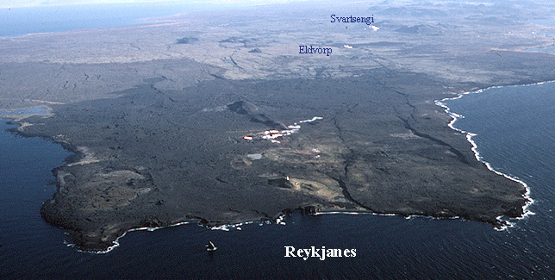
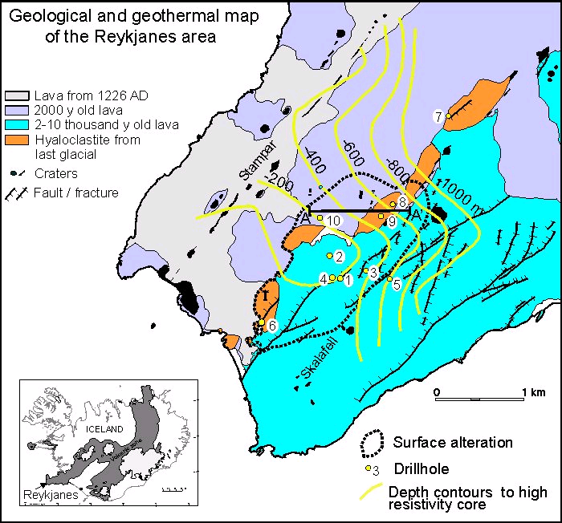
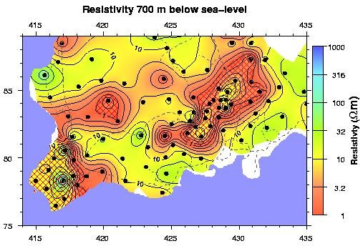
Geological, geophysical, and hydrothermal structure of Reykjanes peninsula
IDDP2
2005-2007
IDDP 2
Map of electrical resisitivity at 700 m depth

Slide 16
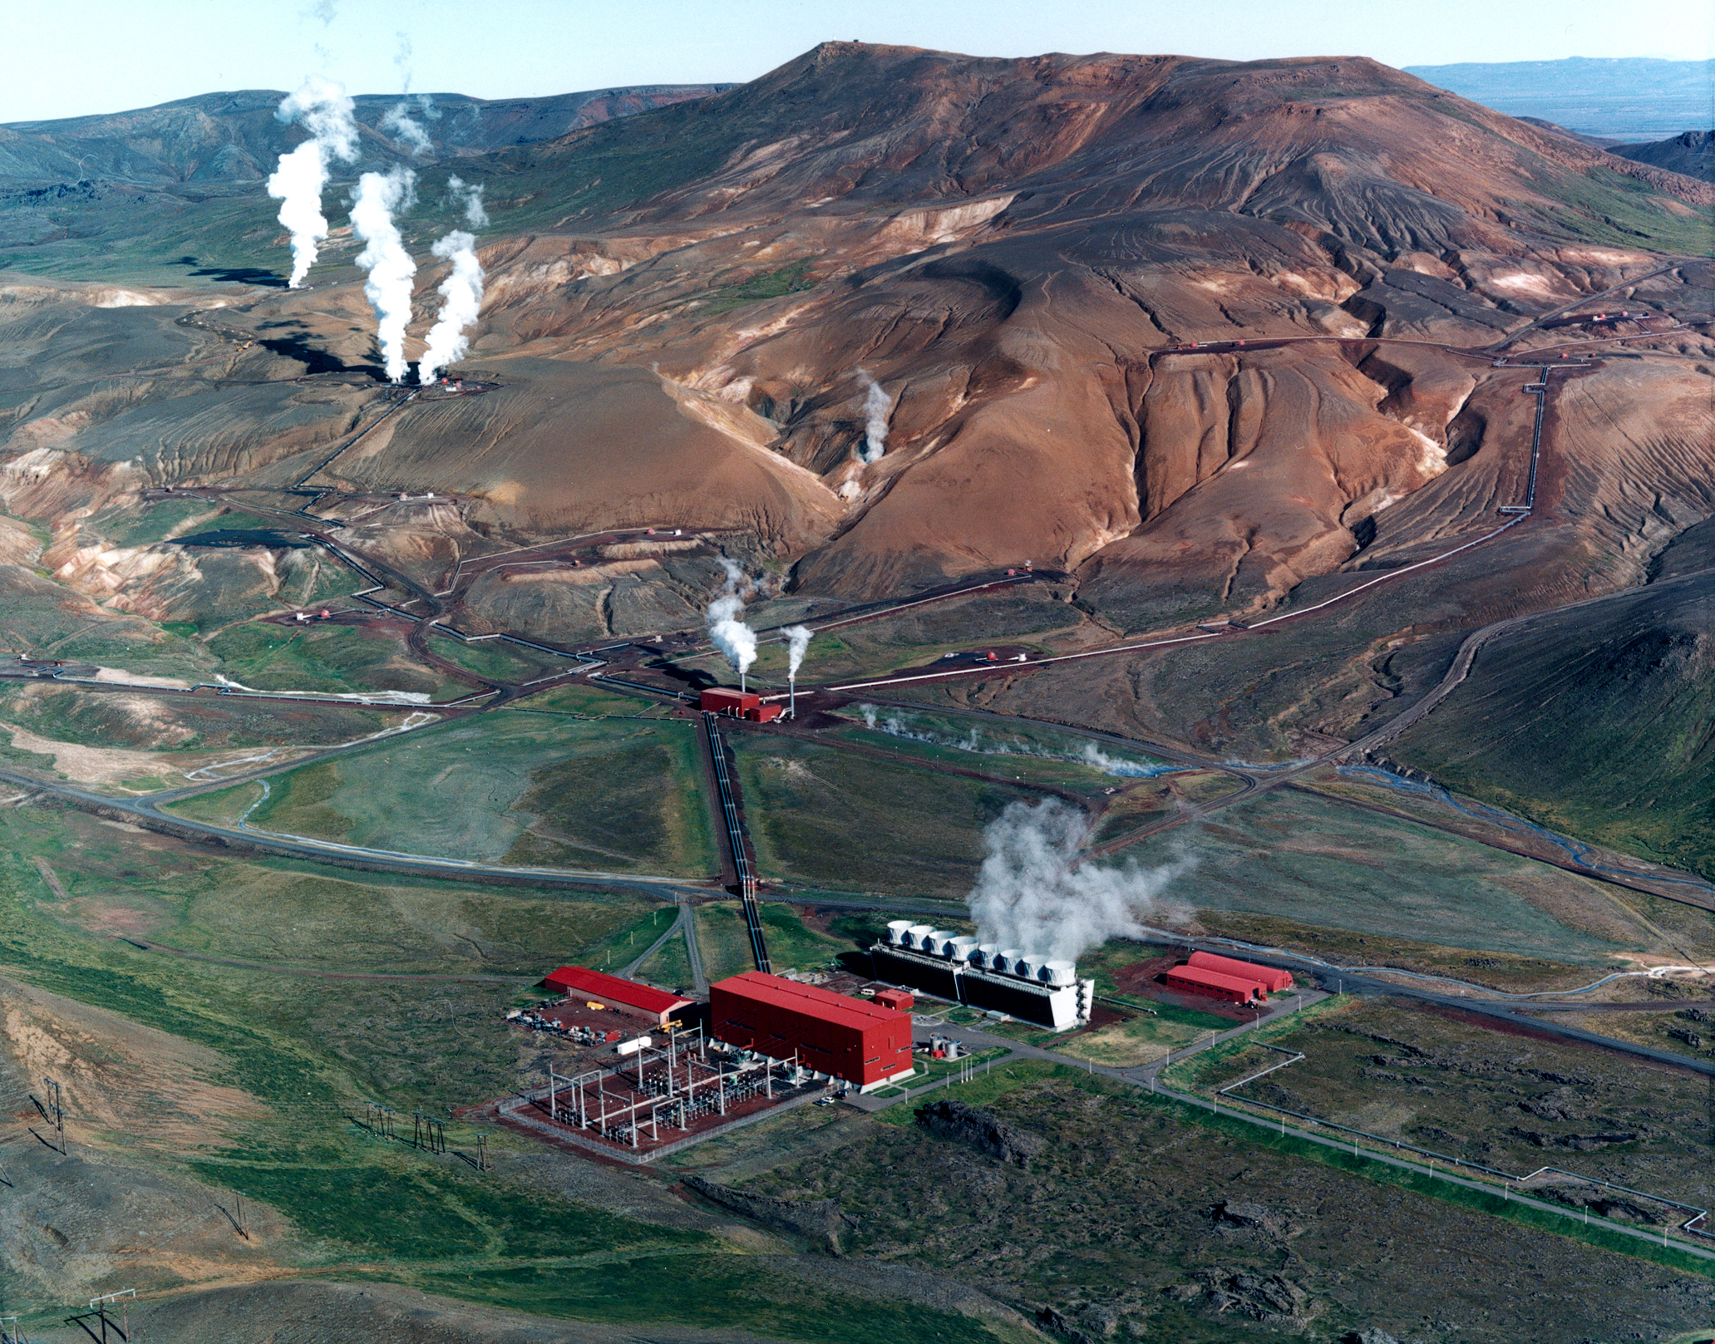
Geological, geophysical, and hydrothermal structure of Krafla volcano
Krafla central volcano
Notes:
The 60 MWe Krafla power plant. The yellow arrow points to the potential IDDP drillsite.

Slide 17
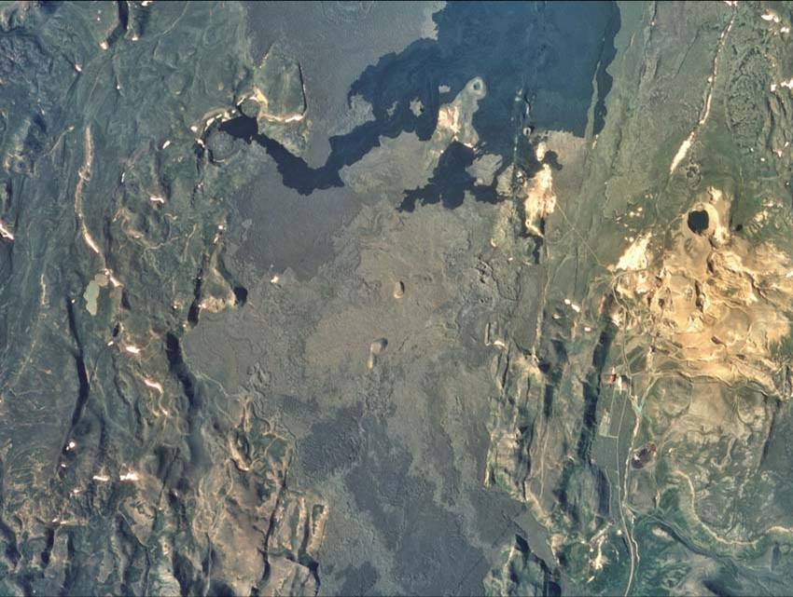
IDDP1-well
Krafla power plant
Notes:
The black lava flow erupted during the 1975-1984 volcanic episode.
The dark circular feature in the light colored hydrothermal surface manifestation at the right side of the aerial photo is the Viti explosive crater, from the first eruption during the 1724-1729 (also small eruption in1741) volcanic episode in Krafla.

Slide 18
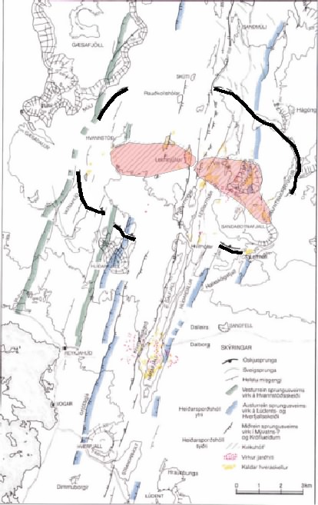
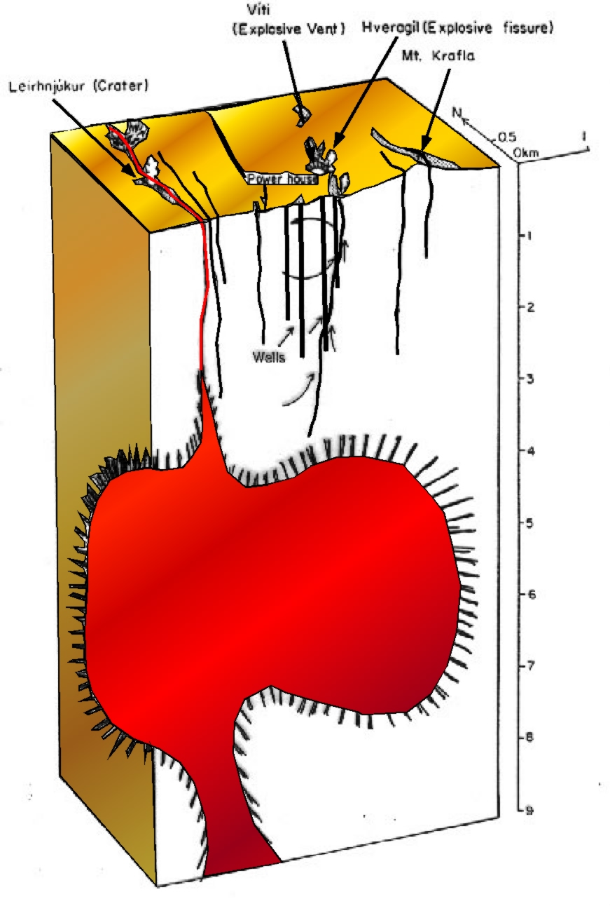
Krafla central volcano
Notes:
The Krafla magma chamber was mapped by S-wave attenuation during the Krafla fires (1975-1984)
The red bar indicates the location of a section across the Krafla drill field in the next slide.
The dot indicates the location of the power plant

Slide 19
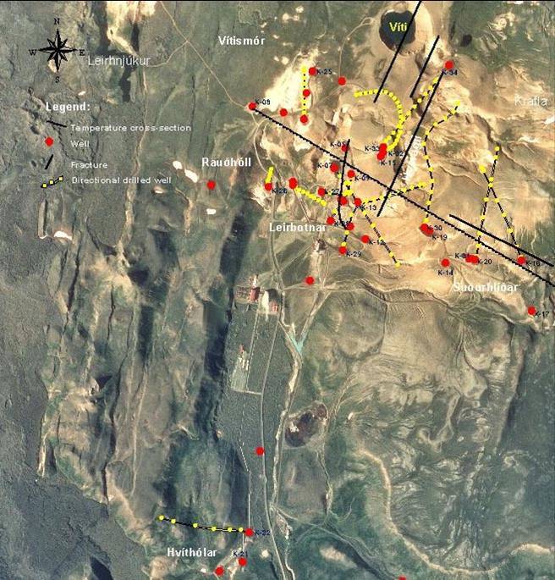
K-34
K-26
IDDP
K-6
Notes:
Close up on aerial photo

Slide 20
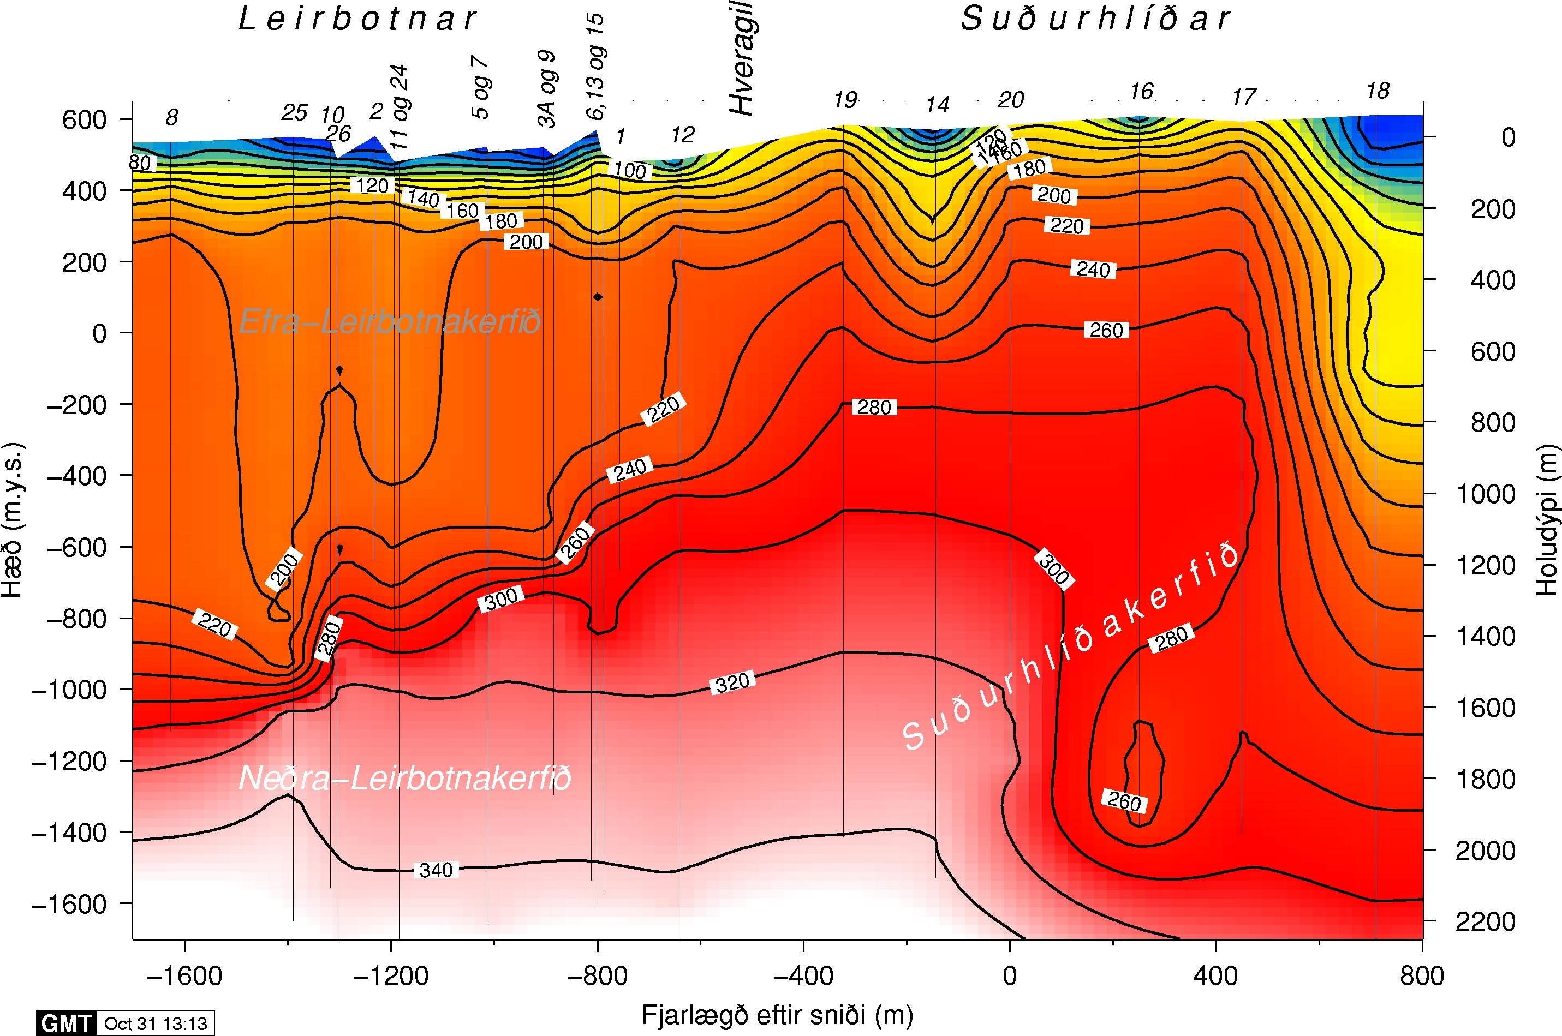
~ 4-5 km

Slide 21
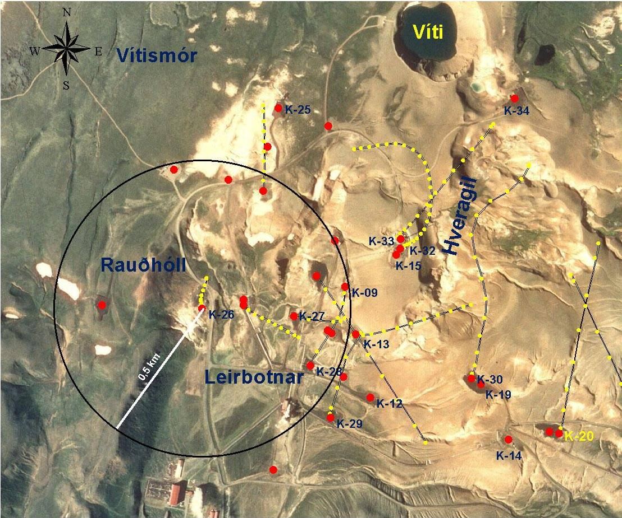
Notes:
The red star shows the potential location of the first IDDP drillhole in Krafla.
The IDDP well is close to the current re-injection well KG-26 which is slightly incline towards the north (yellow dots)
The next slide show the temperature and pressure condition in well KG-26
Similar PT conditions are likely in the IDDP well
According to the pressure profiles a permeable zone at somewhat higher pressure is expected at 2400 m depth

Slide 22
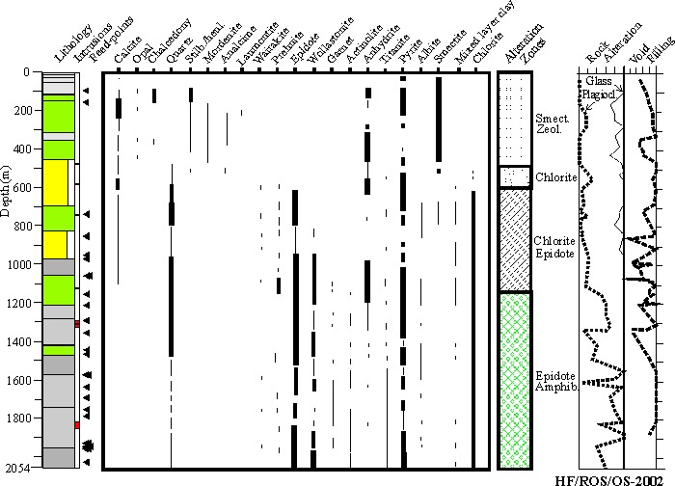

Slide 23
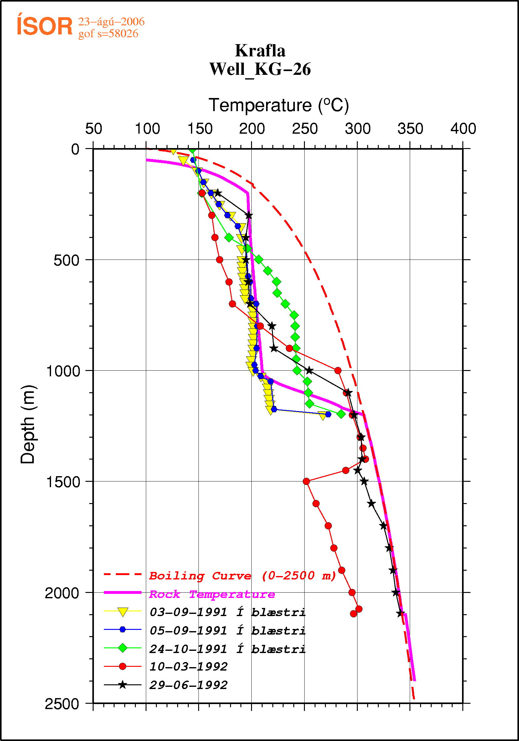
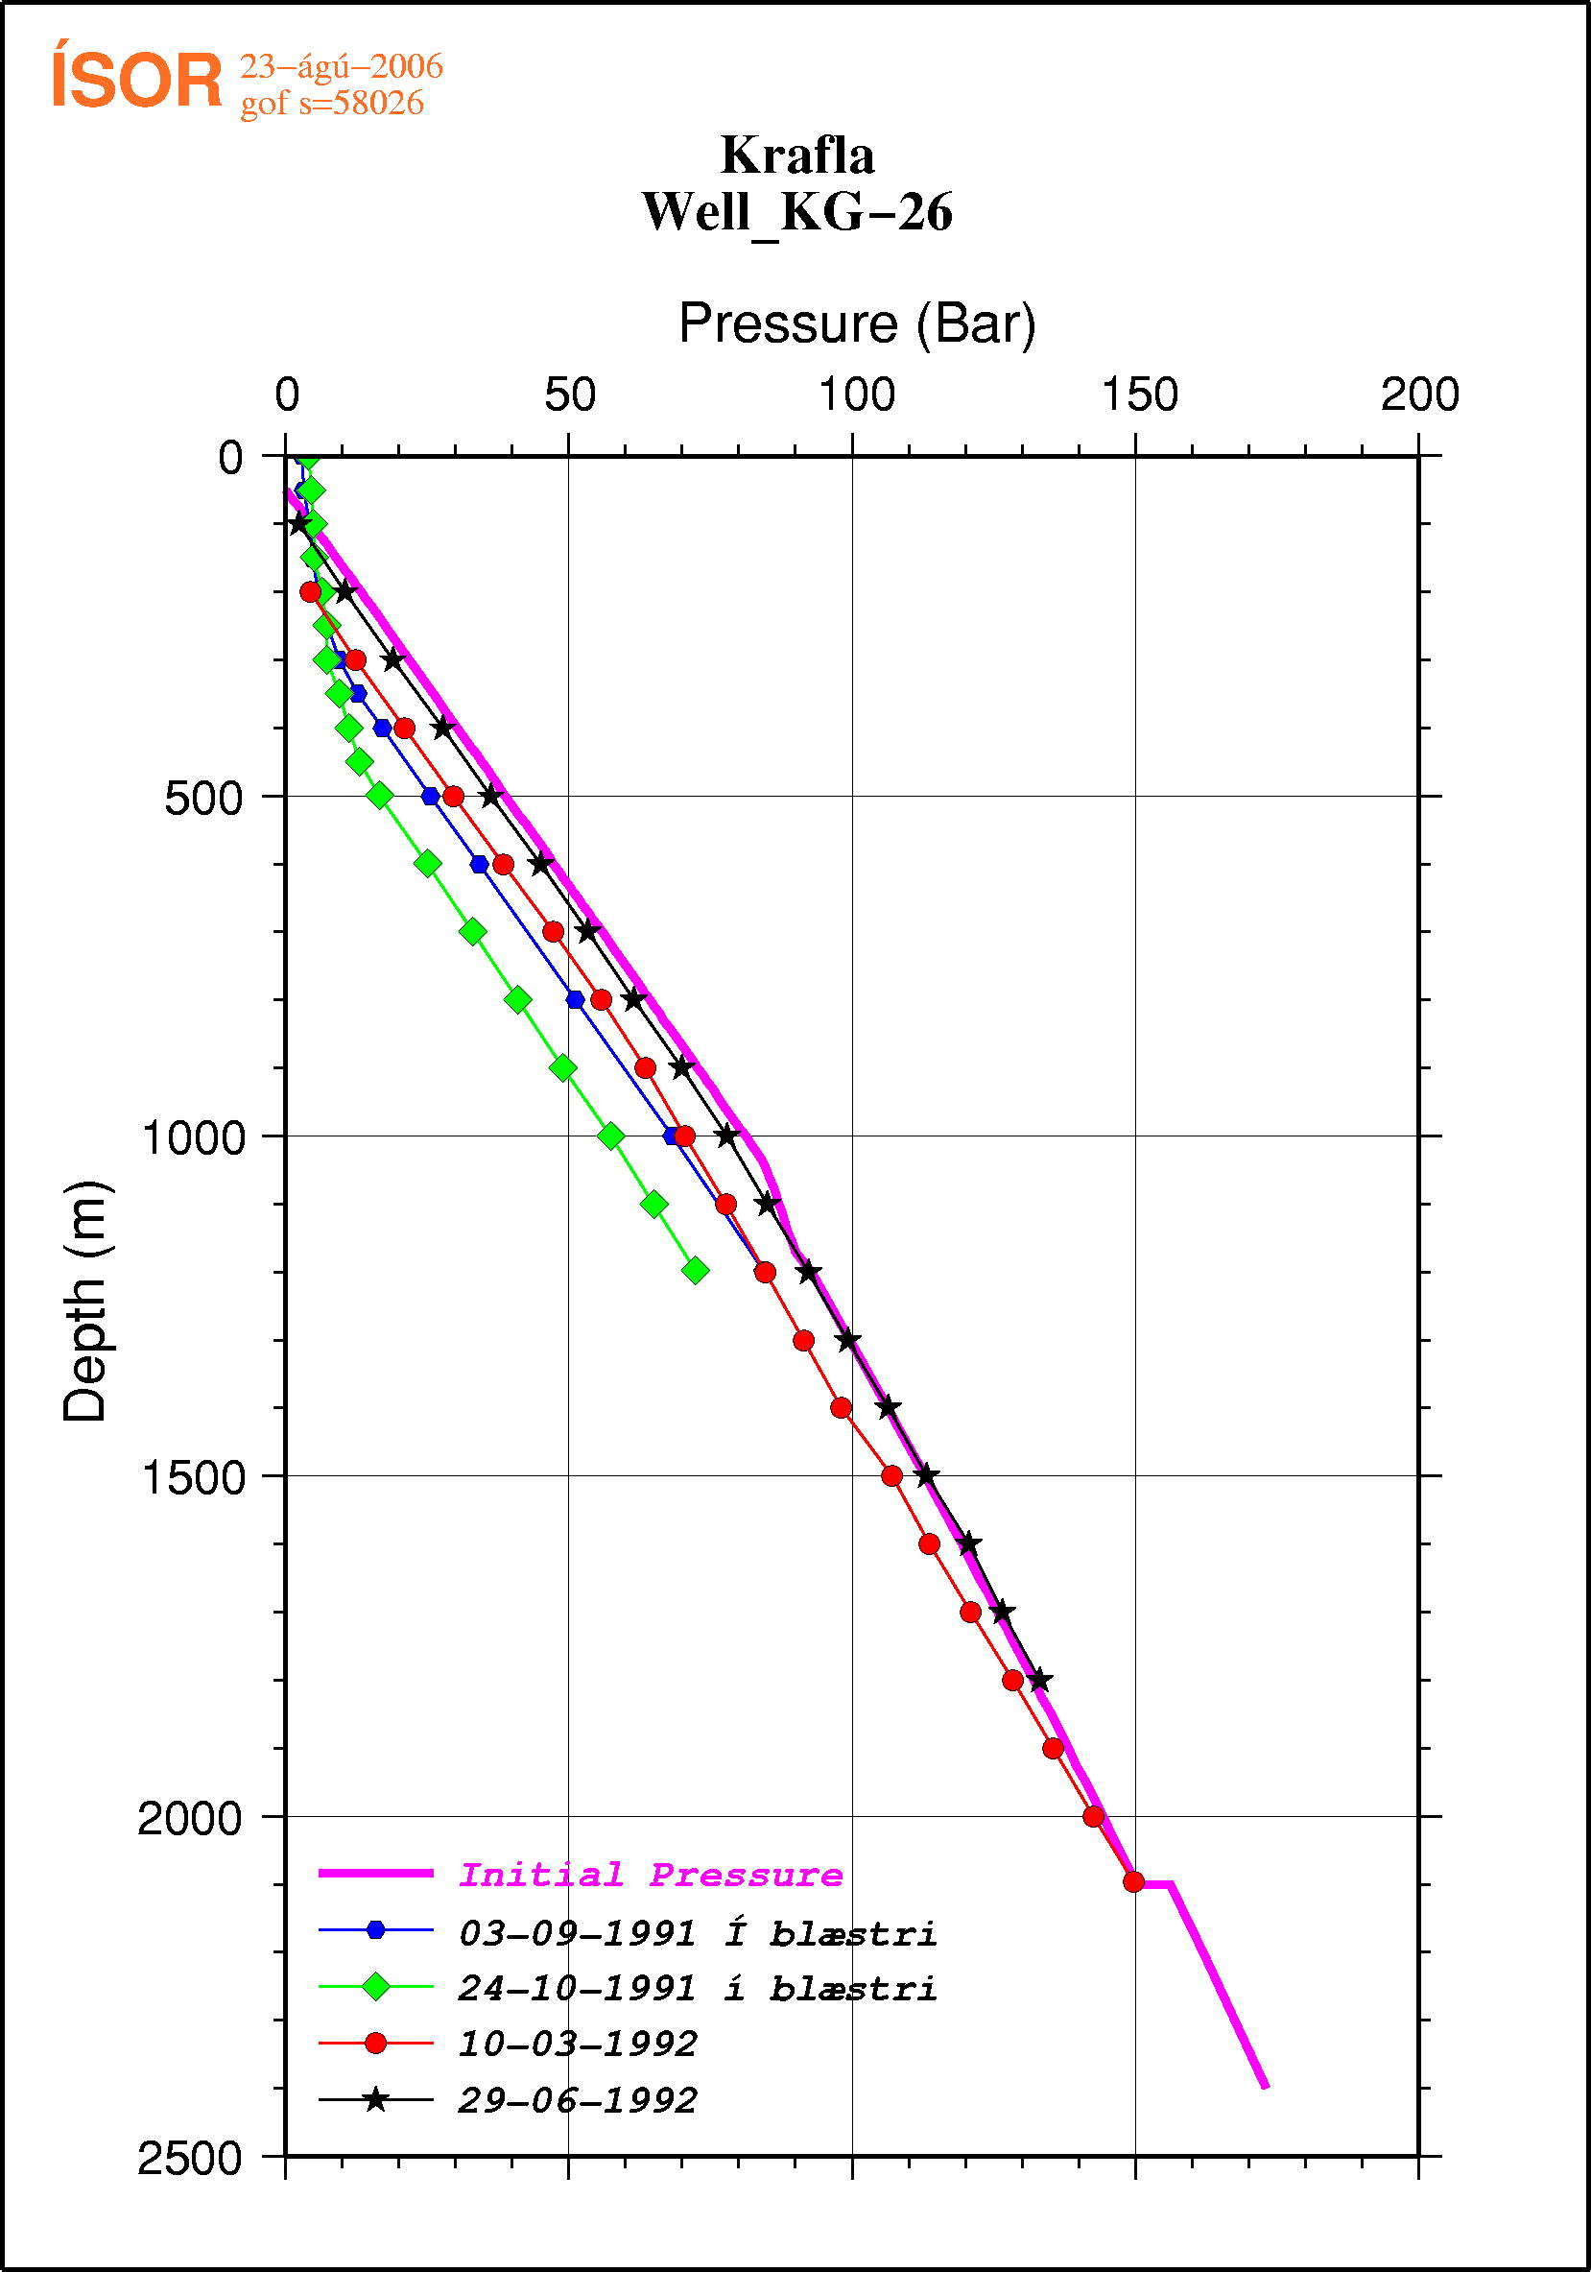
Notes:
temperature (T) and pressure (P) profiles for the KG-26 well in Krafla.
The western part of the Krafla production fields (Leirbotnar) is characterized by an upper and lower fluid systems – the upper one roughly at 200°C while the lower part, below 1000-1200 m depth, follows the BPD-curve
With increasing depth we expect T will arise along the BPD-curve to the critical point (CP) at ~3.5 km depth. There are some indication that the P may be slightly higher so a superheated steam field is also possible.
In the next slide two possible scenarios are shown – (a) superheated steam field above supercritical reservoir, and (b) that the T condition follows the BPD curve to the CP and into supercritical conditions.
These two scenarios were discussed at an IDDP workshop in 2001 – based on field evidence from a deeply eroded Miocene central volcanic complex in SE-Iceland. Both scenarios may apply to the Krafla drillfield – depending on drillsite location with respect to the underlying magma chamber.

Slide 24
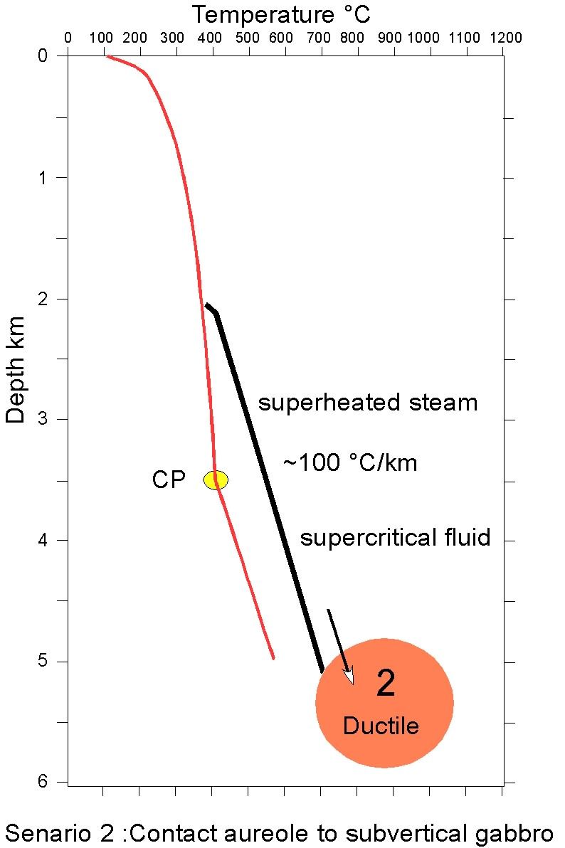
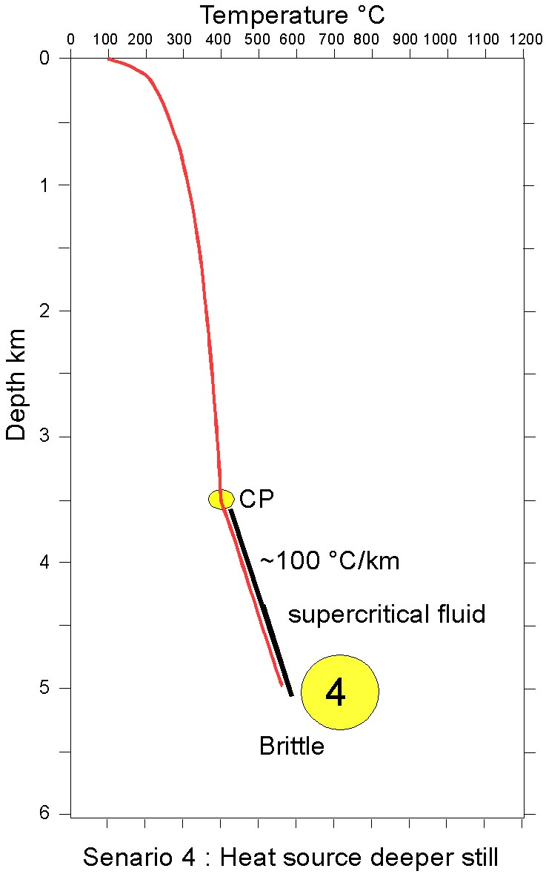
These are the type of drilling targets IDDP seeks
Depth of the production casing in Krafla will be ~3.5 km
Notes:
Models for scenarios 2 and 4 presented at at IDDP workshop in 2002
Either model is expected to apply to the IDDP well in Krafla – while the plan is to case the well off at ~3.5 km in order to secure not mixing sub-critical fluid with the supercritical

Slide 25
Key questions
Hydro-mechanical regime ?
• mechanical behavior of the crust ?
• geothermal implications: Permeability?
• hole stability ?
Phase diagram ?
(supercritical conditions ?)
Solubility of metals ?
Corrosion?
Reservoir evaluation?
... etc ...

Slide 26
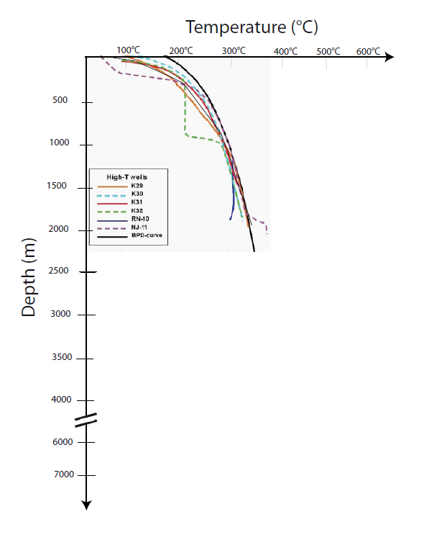
Why studying the brittle to ductile transition?
+ Supercritical fluids (374°C, 22 MPa)
+ Simpler design owing to homogeneous rock properties beyond the BDT
+ Minor impact on shallow hydrothermal systems
+ Lesser probability for induced earthquakes of damaging magnitudes
Limit of permeability
Strain partitioning (Heterogeneity)
Supercritical fluids
Maximal depth of fluid circulation
Seismic cut-off
Fridleifsson et al., (2003)
4

Slide 27
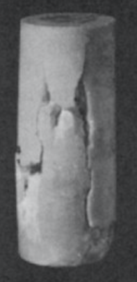
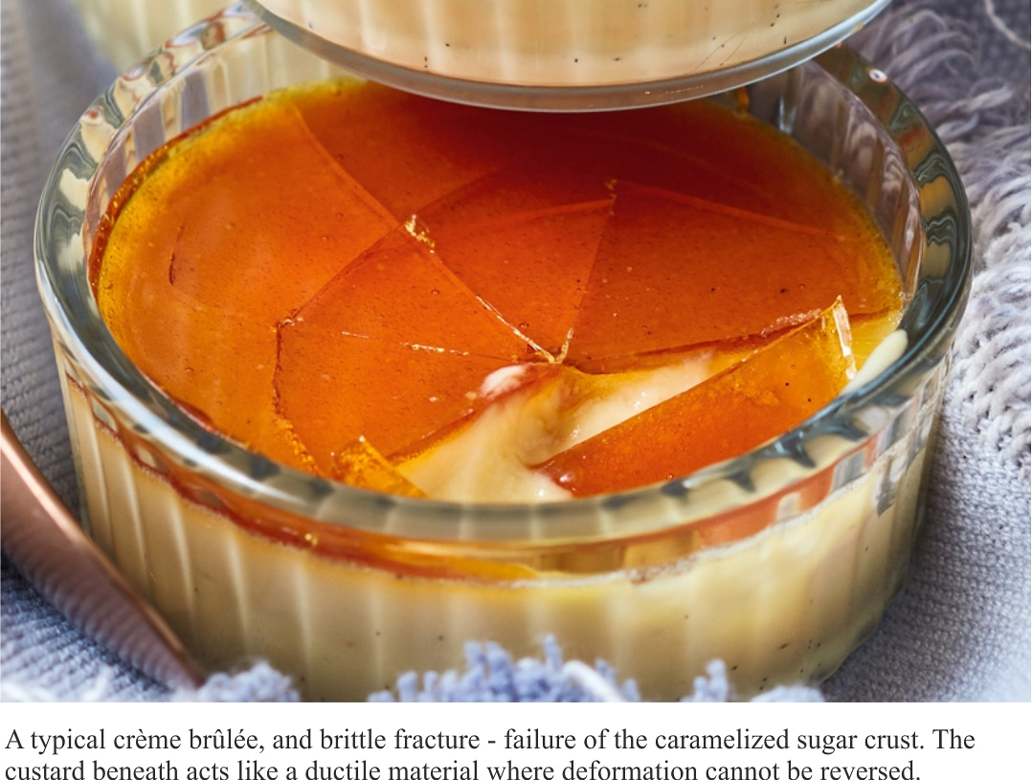
What is the BDT?
Strength (MPa)
Lab samples
Brittle
Brittle fracture
The Earth’s lithosphere can be divided into 2 distinct layers:
Brittle: faults, controlled by friction
Depth (km)
Burgmann and Dresen, 2009
10 mm
Paterson et al., 1958
Byerlee, 1968, Kirby, 1983,
Kolhlstedt et a., 1995
Evans et al., 1990
5
Notes:
What is the BDT? The lithosphere can be divided into two layers. The upper layer is brittle, with deformation occurring through faulting and strength governed by friction, much like the caramelized crust of a crème brûlée."

Slide 28
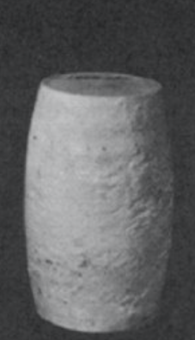
What is the BDT?
Strength (MPa)
Lab samples
Brittle
Brittle fracture
The Earth’s lithosphere can be divided into 2 distinct layers:
Brittle: faults, controlled by friction
Ductile: homogeneous deformation, controlled by crystal plasticity
Depth (km)
Ductile
Burgmann and Dresen, 2009
Ductile substrate
10 mm
Paterson et al., 1958
Byerlee, 1968, Kirby, 1983,
Kolhlstedt et a., 1995
Evans et al., 1990
5
Notes:
In contrast, the bottom layer experiences deformation through crystal plasticity, with homogeneous deformation and strength approximated by high-temperature flow law, akin to the custard of a crème brûlée.

Slide 29
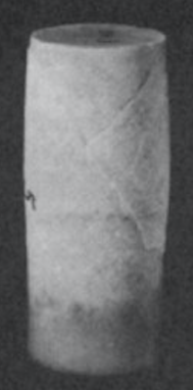
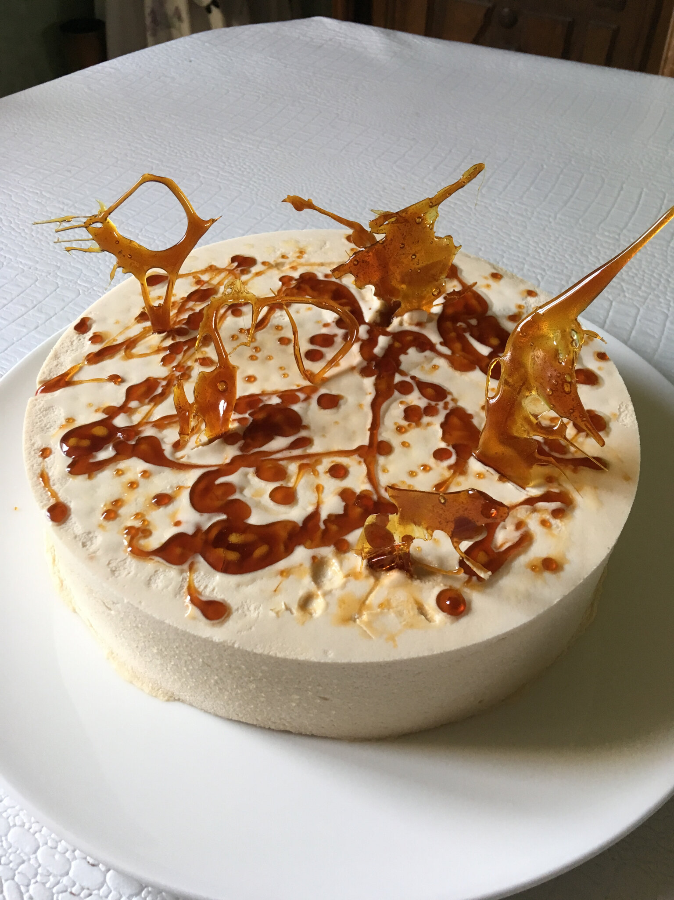
What is the BDT?
Strength (MPa)
Lab samples
The brittle-to-ductile transition:
No clear boundaries
Combination of faulting & crystal plasticity
Strain is partitioned between the fault plane and the rock mass.
No mechanical laws
Sparse observations
Brittle
Brittle fracture
BDT
Depth (km)
Ductile
Ductile substrate
10 mm
Paterson et al., 1958
Byerlee, 1968, Kirby, 1983,
Kolhlstedt et a., 1995
Evans et al., 1990
5
Notes:
The transition from the brittle upper layer to the ductile lower layer of the lithosphere isn't marked by a distinct boundary. Within this zone, we find a mix of both brittle and ductile behaviors, with deformation being partitioned between the fault plane and the rock mass. There are no mechanical laws describing the rheology, and our observations of this transition are sparse.

Slide 30
What is the BDT?
Strength (MPa)
Lab samples
The brittle-to-ductile transition:
No clear boundaries
Combination of faulting & crystal plasticity
Strain is partitioned between the fault plane and the rock mass.
No mechanical laws
Sparse observations
Brittle
Brittle fracture
BDT is an umbrella term for two transitions:
Transition in mode of deformation (LDT) (Meyer et al., 2019, Meyer and Violay 2023)
Transition in type of deformation (BPT) (Frederich et al., 1989)
BDT
Depth (km)
Ductile
Ductile substrate
10 mm
Paterson et al., 1958
Byerlee, 1968, Kirby, 1983,
Kolhlstedt et a., 1995
Evans et al., 1990
5
Notes:
The transition from the brittle upper layer to the ductile lower layer of the lithosphere isn't marked by a distinct boundary. Within this zone, we find a mix of both brittle and ductile behaviors, with deformation being partitioned between the fault plane and the rock mass. There are no mechanical laws describing the rheology, and our observations of this transition are sparse.

Slide 31
The BDT and earthquakes
Strength (MPa)
Brittle
Magnitude
BDT
Depth (km)
Ductile
Paterson et al., 1958
Byerlee, 1968, Kirby, 1983,
Kolhlstedt et a., 1995
6
Notes:
The transition from brittle to ductile behavior significantly influences earthquake dynamics. It serves as both the location for very large magnitude earthquakes, attributed to the high strength in that zone.

Slide 32
The BDT and earthquakes
Strength (MPa)
Frictional Stability
Brittle
Unstable
-
+
Stable
No EQ
Magnitude
Depth
BDT
EQ
Depth (km)
No EQ
Ductile
Paterson et al., 1958
Byerlee, 1968, Kirby, 1983,
Kolhlstedt et a., 1995
Scholtz, 2019
6
Notes:
It also represents a threshold for earthquake nucleation, influenced by changes in frictional properties, meaning that below it, it is very difficult to nucleate an earthquake.

Slide 33

The BDT and earthquakes
Strength (MPa)
Frictional Stability
Brittle
Unstable
-
+
Stable
No EQ
Magnitude
Depth
Extend of rupture
Earthquake scaling law
Fault
BDT
EQ
Depth (km)
No EQ
Ductile
Off-fault deformation
Paterson et al., 1958
Byerlee, 1968, Kirby, 1983,
Kolhlstedt et a., 1995
Scholtz, 2019
Meyer et al., under review
7
Notes:
Additionally, it governs the maximum extent of seismic earthquake rupture and controlled earthquake scaling laws.

Slide 34
Main questions
At what depth is the brittle-ductile transition (BDT) located, can supercritical fluid extraction possible?
How does off-fault ductile deformation affect geothermal reservoir porosity and permeability?
How does off-fault ductile deformation affect mode I and mode II fractures propagation/stability?
8

Slide 35
Strategy
We reproduce geothermal reservoirs in the lab under BDT conditions.
Strain rate (/s)
10⁻⁹
10⁻⁶
10⁻³
10⁰
10³
inter-seismic
seismic
2
4
6
Depth (km)
8
10
9
Notes:
In particular, we will replicate earthquakes in the laboratory under conditions representative of the brittle-ductile transition throughout the entire seismic cycle. We will use two recently developed and unique apparatuses.

Slide 36
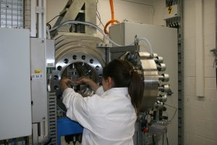
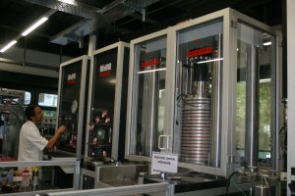
Strategy
We reproduce géothermal reservoirs in the lab under BDT conditions.
Strain rate (/s)
10⁻⁹
10⁻⁶
10⁻³
10⁰
10³
inter-seismic
seismic
2
Target
HP, HT Triaxial Press
HighSTEPS
High Speed Friction Apparatus
Chemical
4
6
Slip rate µm/s to m/s, 100 °C, 100 MPa
Depth (km)
Violay et al., 2021
8
10
1000°C, 400 MPa
Meyer et al., 2023
9
Notes:
Additionally, we will employ the TRAGET machine capable of reaching pressures of up to 400 MPa and temperatures of up to 1000°C, while applying large differential stresses on relatively large faulted rock samples to reproduce earthquakes. This machine will be equipped with a laser vibrometer and high-frequency strain gauges to respectively record the dynamic slip and stress during laboratory earthquakes. This represents the most challenging technical aspect of the project.

Slide 37
Main questions
At what depth is the brittle-ductile transition (BDT) located, can supercritical fluid extraction possible?
How does off-fault ductile deformation affect geothermal reservoir porosity and permeability?
How does off-fault ductile deformation affect mode I and 2 fractures propagation/stability?
10

Slide 38
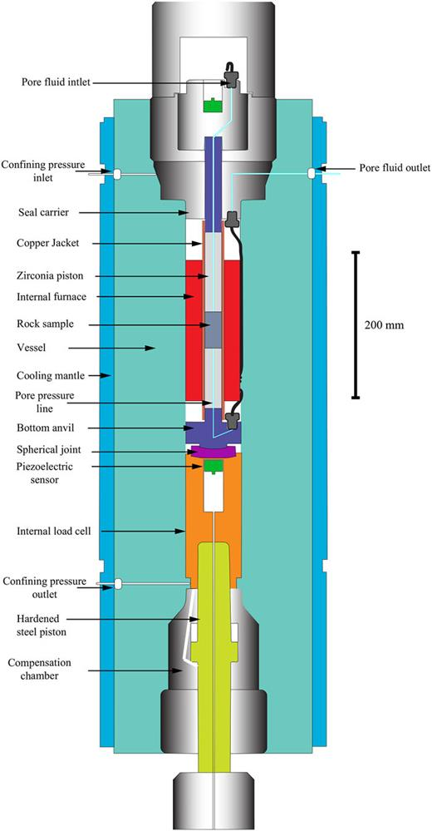
Target press characteristics
Pconf 400 MPa
Pp 300 MPa
400°C <T<1200°C
10⁻⁷ s⁻¹<έ<10⁻² s⁻¹
Large sample, 20/24 mm diam.
Semi-internal load cell
Hemispherical joints
Permeability measurements
Piezo-electric sensors
Novelty
Meyer et al., 2023
11

Slide 39
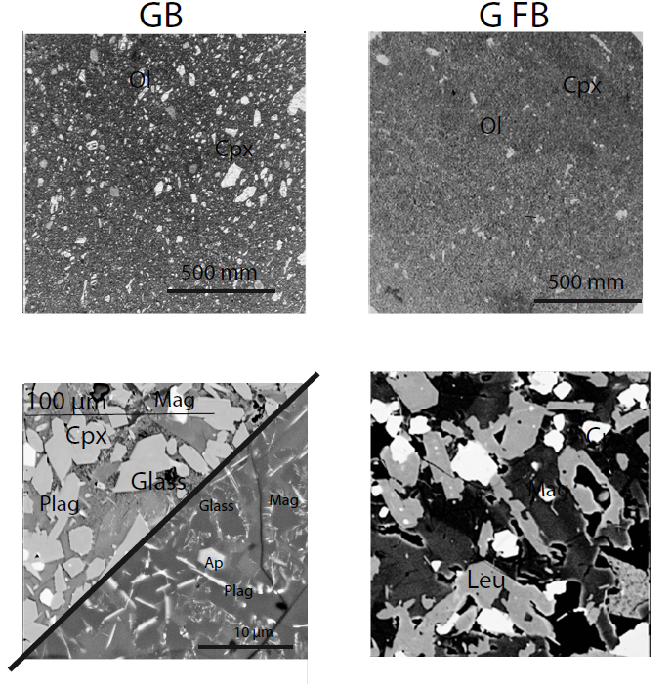
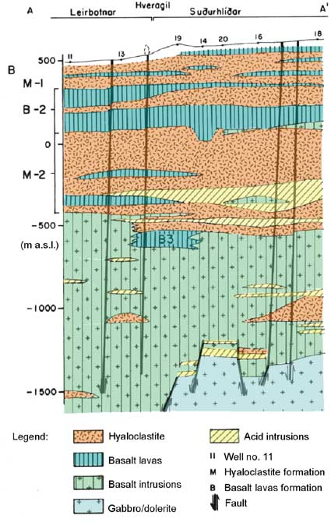
Starting sample.
Basalt
Hyaloclastite
Gabbros
Notes:
2 basalts selected for their simple composition, low degree of alteration and their very low porosity.

Slide 40
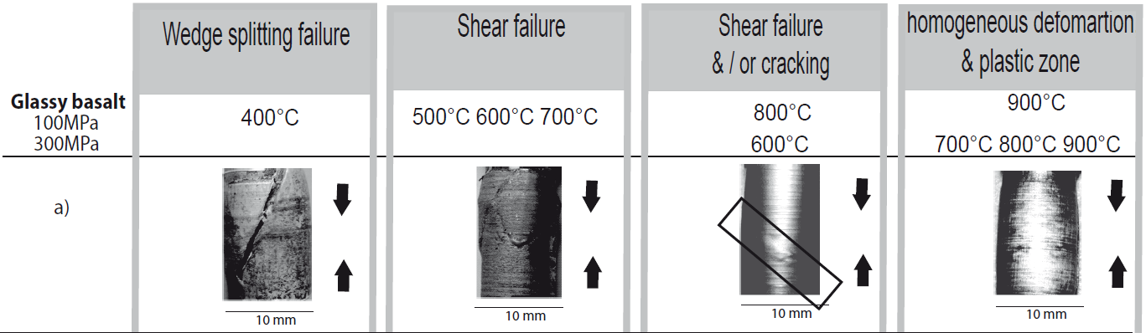
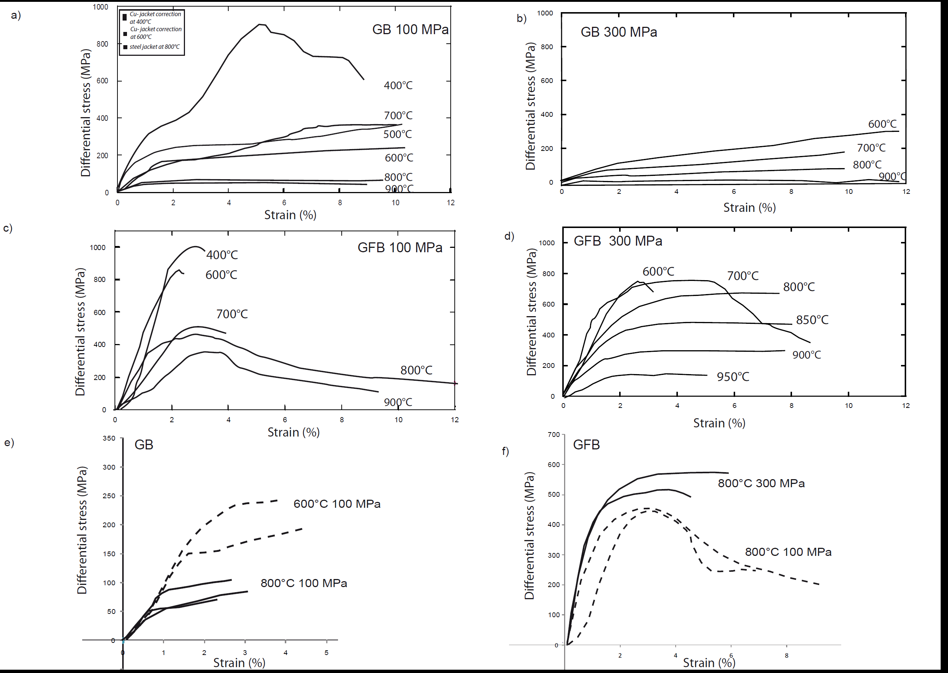
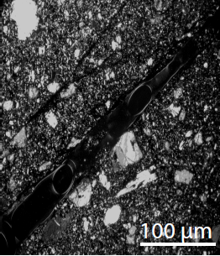
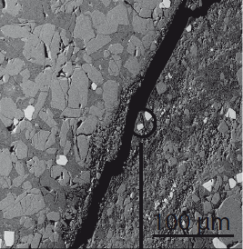
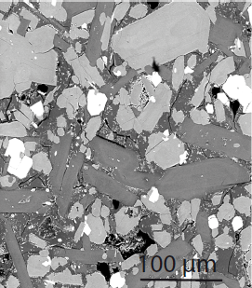
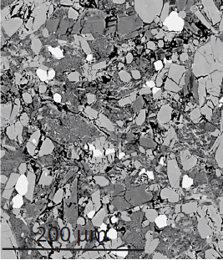
GB sample.
10⁻⁵s⁻¹
Notes:
<<<<<<<DEFORMATION A VITESSE CONSTANTE>>>>>>>>>
4 modes de deformations :
1)
2) fluage cataclastiq à contrainte constante
4 mode intermediaire
3)Deformation homogene

Slide 41
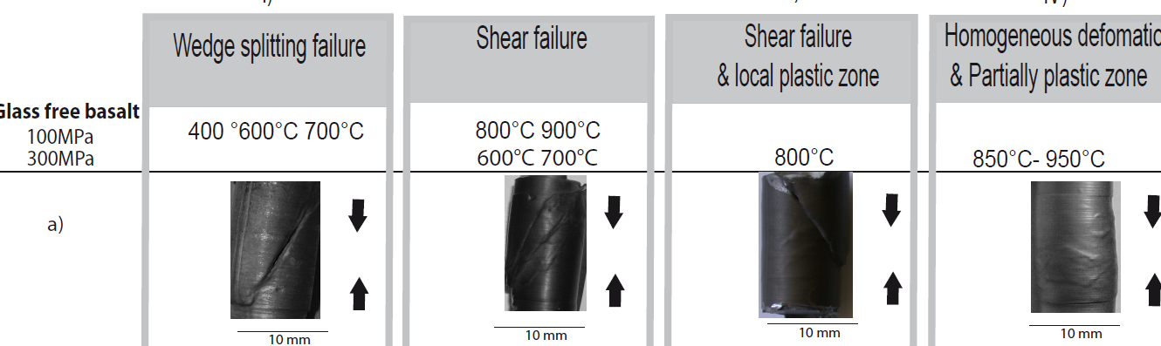
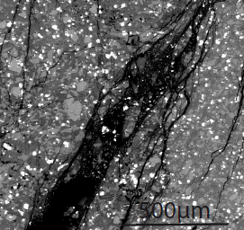
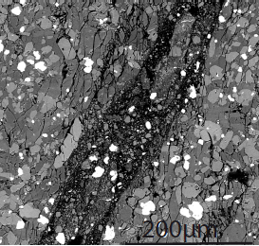
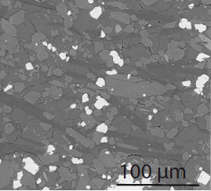

GFB sample.
10⁻⁵s⁻¹
Notes:
4 modes de deformations :
1)
2) fluage cataclastiq à contrainte constante
4 mode intermediaire
3)Deformation homogene

Slide 42

Wedge spliting
Shear failure
Homogeneous
deformation
Peak strength ➔ localized deformation
2% of strain ➔ distributed deformation
Notes:
PRESSION, CONTRAINTE A LA RUPTURE
FIGURéS PLEINs FERMés
Rond CARRE
Orange temperature de ttransitions fragile ductile
<<<<<<<<<<<DEFINITI MACROSCOPIQUEMENT>>>>

Slide 43
Transition fragile/ductile
• Basse temperature transition fragile-ductile
–fracturation - fluage cataclastique
• haute temperature transition fragile-ductile
– cataclastique - fluage plasticité intra-cristalline, fluage par diffusion

Slide 44

Mécanisme de déformation
5 catégorie:
1) Fracturation, fluage cataclastique, and glissement.
2) Fluage par dislocation
3) Fluage par diffusion
4) Fluage par dissolution
5) Jumellage

Slide 45
Mécanismes de déformation
De nombreux facteurs influencent l’activation (ou non) de mécanismes de def.
Minéralogie, taille de grain
Température
pression de confinement pression de pore
Contrainte diff.(σ₁ - σ₃)
vitesse de def.
Bcp de roche poly-mínéraliques ont plusieurs mécanismes de def. activés en même temps
Si les conditions changent durant la déf, les mécanismes changent aussi.

Slide 46



Cataclastique
Pression et temperature
Diffusion
Intracrystalline
Vitesse déformation

Slide 47

General form of a flow law
$\dot{ε}=A{(σ_{1}\text{−}σ_{3}\text{) }}^{n}$ ${\text{e}}^{\left(\frac{−H}{\text{RT} }\right)}$
where:
ε = strain rate, s-1
n = stress exponent
H = activation enthalpy, J mol-1
R = gas constant, J K-1 mol-1
T = temperature, K

Slide 48
Brittle vs. ductile deformation
localization
YES
NO
increasing P and T
increasing strain
increase strain rate/
increase pore pressure
decrease strain rate/
decrease pore pressure
Cataclastic
faulting
Cataclastic
flow
CATACLASTIC
DEFORMATION MECHANISM
Plastic shear
zone
Homogeneous
plastic flow
PLASTIC

Slide 49

Brittle behavior : friction law.
(5%)
τ = C + µσ_{n}
µ = 0.42 and C = 34 MPa.
In the brittle field, GB and GFB behave similarly.
Notes:
SHEAR STRESS STATIC A 5% Normal stress Shear stress angle de la fracture

Slide 50

Ductile behavior : exponential law.
έ=Aσ^{n}e^{(-Q/RT)}
Stress exponent(GB/GFB)➔ 3<n<4.2
Notes:
AXES
DOMAINE FRAGILE SYMBOLE OUVERTS
RELAXATION DES CONTRAINTE
EXPOSANT DE CONTRAINTE ➔ dislocation

Slide 51

Previous studies comparisons.
Notes:
Comparé lois de fluage à 10-5
Inferieure au données des diabases
D’autant plus faible pour l’echantillon GB

Slide 52

Ductile behavior : exponential law.
GB: έ= (1.3±0.8*10⁻⁹).σ ^{(3.7± 0.6).}exp((-59,0 ± 15)/RT)
GFB: έ= (6.1±2.2*10⁸).σ ^{(3.6± 0.6).}exp((-456,0 ± 4)/RT)
Notes:
Axe
Energy d’activation

Slide 53

Geological scale extrapolation.
Earthquake frequency (%)
Reykjanes
Hengil
Krafla
5-6Km
Fridleifsson et Elders (2005)
Hydrothermal fluids might circulate, at least transiently, through the oceanic basaltic crust down to 5 to 6 km depth and supercritical fluids might be expected from 4 to 6 km depth !
Notes:
Extrapolé à des vitesses de def de 10 -14 gradient icelandais.

Slide 54
Geological scale extrapolation.
Earthquake frequency (%)
Reykjanes
Hengil
Krafla
5-6Km
And porosity?
Fridleifsson et Elders (2005)
Hydrothermal fluids might circulate, at least transiently, through the oceanic basaltic crust down to 5 to 6 km depth and supercritical fluids might be expected from 4 to 6 km depth!
13
Notes:
Extrapolé à des vitesses de def de 10 -14 gradient icelandais.

Slide 55

BDT is associated with a decrease of porosity
Basalt
Violay et al., 2015
14

Slide 56

BDT is associated with a decrease of porosity
Basalt
Granite
Violay et al., 2015
14
Violay et al., 2017

Slide 57
BDT is associated with a decrease of porosity
Basalt
Granite
And permeability?
Violay et al., 2015
14
Violay et al., 2017

Slide 58

Method : samples
20 mm
Lanhélin granite
Grain size 2-3 mm
Composition: Quartz 40%, K-feldspar 35%, plagioclase 25%
Isotropic and homogeneous
Experimental conditions
150 MPa P_{ceff}
50 MPa P_{p}
Argon as pore fluid (chemically inert)
T from 200 to 800 ℃
Strain rate: 10⁻⁶ s⁻¹
See Gabriel Meyer’s poster
15
Notes:
The rock of choice for this study was Lanhélin granite that we believe represent the rocks that can be encountered in deep crystalline reservoirs. It has the following properties.
We put the samples in our machine and apply those conditions. Most importantly, the pore fluid was argon, a chemically inert fluid.
We deformed the sample really slowly, t 10-6 and the key is that during the experiment, we recorded permeability continuously.

Slide 59
Method : permeability
Harmonic permeability method
Pressure oscillation continuously during entire experiment.
Oscillations applied to the top end of the sample.
Amplitude of 5 MPa
Period of 20 minutes
Transmitted oscillations recorded at the bottom of the sample.
Apparent permeability recording direction
Fisher and Paterson, 1992,
Bernabé et al., 2006
16
Notes:
We used the harmonic permeability method whereby we apply a pore pressure oscillation to one end of the sample. Here it was on the top end of the sample and had an amplitude of 5 Mpa and a period of 20 minutes.

Slide 60

Mechanical results
Between 200 and 600 ℃, exhibits brittle localized deformation with stress drop.
Semi-ductile at 800 ℃ and yielding is followed by strong non-linear deformation up to a stress plateau.
Meyer et al., accepted Nat. comm
17
Notes:
Here I am showing you the stress strain curve for all deformed samples. What I want you to see, is that fromm 200 to 600 degree, the sample show the classic behaviour of localized deformation with a high strength and a stress drop at the moment of failure.
At 800, the sample strength is halved and there is no drop. The stress strain behavior just rolls over and plateaus as the rock flow. This behavior is semi-ductile, and I will come back to why I’m calling it semi, here.

Slide 61
Permeability results
Initial permeability k₀ was consistently around 10⁻¹⁹ m².
In brittle regime, k remains roughly constant throughout deformation.
In semi-ductile regime, permeability skyrockets 35-fold.
Meyer et al., accepted Nat. comm
18
Notes:
Now let’s have a look at perm.
Here, I am plotting the sample permability during deformation normalized by the sample permeability just before deformation, so under pressure and temperature.
What I want you to see here is that at 200 and 400, perm basically remains constant throughout.
At 600, we can see a slight increase coinciding with sample failiure,
At 800C, permeability soars 35 fold and the increases does not seem to be tapering off.

Slide 62
Permeability results
Initial permeability k₀ was consistently around 10⁻¹⁹ m².
In brittle regime, k remains roughly constant throughout deformation.
In the semi-ductile regime, permeability soars more than thirty-five fold.
With increasing temperature and ductility, permeability increases…
Given previous observations, it is counterintuitive !
We went to the synchrotron...
18
Notes:
But this result is counterintuitive. Violay and coworkers showed that the more ductile a rock became and the less porosity was created when deforming. So how can the more ductile rock be more permeable ?
To answer this, we went to the synchrotron.

Slide 63

Results : post-mortem image analysis
X-ray scans of the post-mortem specimens at the ESRF synchrotron facility, beamline BM18, in Grenoble, FR.
X-ray images were processed to recreate the 3D volume of the whole samples.
19

Slide 64

Results : post-mortem image analysis
200 ℃ — localized
800 ℃ — semi-ductile
19
Notes:
On the left, you can see the sample deformed at 200C, the localized sample. Here we can see a nice sharp fracture in an otherwise rather undamaged bulk.
On the right, you have the semi-ductile sample. And you can now see why I call it semi-ductile. We still have some form of localization in a band right here, but this band is embedded in a highly damaged bulk rock. We can see that here, strain is partitioned between this deformation band and the bulk

Slide 65
Results : post-mortem image analysis
Crack
isolation/segmentation
Permeability simulations in x, y, and z directions were carried out in sub-volumes of the samples
Absolute permeability from Darcy's law.
20
Notes:
Absolute permeability simulations in x, y, and z directions were carried out in sub-volumes of the samples using the Avizo XLab extension. The software computes the absolute permeability from Darcy's law.

Slide 66
Results : computed permeability data in loading direction
k₁ = 5.45 10⁻¹² m²
k₃ = 0.2 10⁻¹² m²
k₄ = 9.1 10⁻¹² m²
k₆ = 5.5 10⁻¹² m²
Fault
Bulk
21

Slide 67
Results : computed permeability data in loading direction
k₁ = 5.45 10⁻¹² m²
k₃ = 0.2 10⁻¹² m²
Depressurization introduces an absolute difference in permeability
Permeability in the deformation bands is comparable in brittle and semi-ductile samples.
Permeability in the bulk is 10x greater in the semi-ductile sample than in the brittle samples.
k₄ = 9.1 10⁻¹² m²
k₆ = 5.5 10⁻¹² m²
Strain partitioning = permeability partitioning
21

Slide 68
Discussion : strain and permeability partitioning
Strain partitioning exerts a first order control on sample apparent permeability.
Permeability is a complex parameter that varies in space.
22

Slide 69
Discussion : strain and permeability partitioning
Strain partitioning exerts a first order control on sample apparent permeability.
Permeability is a complex parameter that varies in space.
Is the increase in permeability in semi-ductile reservoirs a transient phenomenon ?
22

Slide 70
Time dependence of permeability
Experiments in wet thermally cracked granite:
P_{eff} = 80 MPa
P_{p} = 30 MPa of deionized water
Initial permeability around 5.10⁻¹⁸ m²
Permeability decrease by almost an order of magnitude in less than 12 hours !
Phenomenon is chemical and not mechanical (occurring with inert fluid)
23

Slide 71
Time dependence of permeability
Experiments in wet thermally cracked granite:
P_{eff} = 80 MPa
P_{p} = 30 MPa of deionized water
Initial permeability around 5.10⁻¹⁸ m²
Permeability decrease by almost an order of magnitude in less than 12 hours !
Phenomenon is chemical and not mechanical (occurring with inert fluid).
24

Slide 72
Time dependence of permeability
Experiments in wet thermally cracked granite:
P_{eff} = 80 MPa
P_{p} = 30 MPa of deionized water
Initial permeability around 5.10⁻¹⁸ m²
Permeability decrease by almost an order of magnitude in less than 12 hours !
Phenomenon is chemical and not mechanical (occurring with inert fluid).
How to enhance permeability at BDT?
24

Slide 73
Main questions
At what depth is the brittle-ductile transition (BDT) located, can supercritical fluid extraction possible?
How does off-fault ductile deformation affect geothermal reservoir porosity and permeability?
How does off-fault ductile deformation affect mode I and mode II fractures propagation/stability?

Slide 74
Methods to enhance permeability
σ3
σ3
σ1
σ1
P< σ3
P> σ3
Hydraulic fractures: Mode I cracks
Fluid driven frictional ruptures
25

